Slide 1

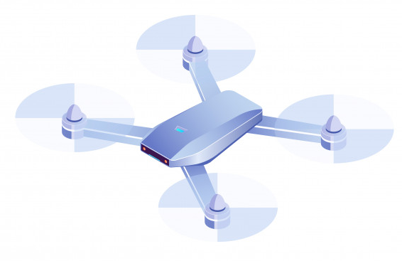







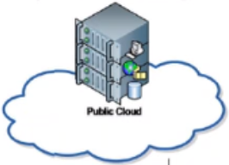





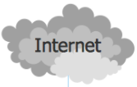




Quantum Safe Security VPN Data Flow Architecture Diagram
Quantum Safe Solution: Device Installed QS-WGVPN Client Program.
SkyRanger R70 UAV
UAV Navigation and Surveillance Video Signal.
Encrypted UAV Navigation and Surveillance Video Signal From VPN Client to Server.
Customers’ Mobile Handhold Devices
Encrypted UAV Navigation and Surveillance Video Signal From VPN Server to Client.
Comm Link 5G LTE
Router Configuration
Ruggedized Laptop
IVH-VMS and VAP
(Hosted at Cloud Platform)
5G Garage Demo Rm
View Client
View Client
5G Serving Base Station
On-Promises VA Server
5G CPF
Ubuntu VM
Internet
Router
QS-WGVPN Server Program

Slide 2
Quantum Safe Security VPN Data Flow Architecture Diagram
Quantum Safe Solution: Device Installed QS-WGVPN Client Program.
SkyRanger R70 UAV
UAV Navigation and Surveillance Video Signal.
Encrypted UAV Navigation and Surveillance Video Signal From VPN Client to Server.
Customers’ Mobile Handhold Devices
IP: 192.168.1.1
Encrypted UAV Navigation and Surveillance Video Signal From VPN Server to Client.
IP: xxx.xx.xxx.xx
Comm Link 5G LTE
Router Configuration
Ruggedized Laptop
IVH-VMS and VAP
(Hosted at Cloud Platform)
5G Garage Demo Rm
View Client
View Client
IP: 10.1.1.1
5G Serving Base Station
IP: 10.8.8.100
IP: 10.8.8.101
IP: xxx.xx.xxx.xx
On-Promises VA Server
5G CPF
Ubuntu VM
IP: 99.1.1.1
Internet
Router
QS-WGVPN Server Program
IP: 10.8.8.8
IP: 10.9.9.9

Slide 3


Option 1
Camera on drone
Flow 1 – Traffic between camera and VA server. Traffic encrypted between the pair of Quantum-safe Gateways.
Flow 2 – Traffic between VA server at 5G Garage MEC and IVH@Public Cloud.
Flow 3 – Traffic between IVH@Public Cloud and 5G Phone at 5G Garage.
Drone
RF
- Network interface with IP configured
1
-VPN
IVH @ Public Cloud
Base Station
IP: 10.2.2.1
Internet
IP: 10.2.2.2
Quantum GW 1
Viewing Laptop
3
5G Phone
IP: 10.9.9.9
IP: 10.8.8.8
IP:192.168.0.10
5G Router with Switch Ports
IP: 192.168.0.11
5G Network
MEC
2
Tunnel 1
Quantum GW 2
VA Server
8 x vCPU
32GB memory
1 x 2TB HDD
OS: Ubuntu LTS 20.04
8 x vCPU
32GB memory
4 x 2TB HDD
2 x Mustang VPU
OS: Ubuntu LTS 20.04
Docker
IP: 99.1.1.1

Slide 4
Option 1
Camera on drone
Flow 1 – Traffic between camera and VA server. Traffic encrypted between the pair of Quantum-safe Gateways.
Flow 2 – Traffic between VA server at 5G Garage MEC and IVH@Public Cloud.
Flow 3 – Traffic between IVH@Public Cloud and 5G Phone at 5G Garage.
Drone
RF
- Physical Network interface with IP configured
1
Base Station
- Virtual Network interface with IP configured
IVH @ Public Cloud
- Data Flow
Eth0 IP: 192.168.2.2
- VPN Tunnel
GW 1 route table
Eth1 IP: 192.168.2.1
Quantum GW 1
Viewing Laptop
Network Destination | Netmask | Gateway | Interface
192.168.1.0 | 255.255.255.0 | 192.168.0.103 | wg0
192.168.2.0 | 255.255.255.0 | 192.168.0.103 | eth1
default |  |  | eth0
GW 2 route table
Network Destination | Netmask | Gateway | Interface
192.168.2.0 | 255.255.255.0 | 192.168.0.100 | wg0
192.168.1.0 | 255.255.255.255 | 192.168.0.121 | eth1
default |  |  | eth0
Internet
5G Phone
3
Eth0 IP: 10.9.9.9
Wg0 IP: 192.168.0.100
Wg0 IP: 192.168.0.103
Eth1 IP:192.168.1.120
5G Router with Switch Ports
Eth0 IP: 192.168.1.121
5G Network
MEC
Quantum GW 2
2
Tunnel 1
VA Server
8 x vCPU
32GB memory
1 x 2TB HDD
OS: Ubuntu LTS 20.04
8 x vCPU
32GB memory
4 x 2TB HDD
2 x Mustang VPU
OS: Ubuntu LTS 20.04
Docker
IP: 99.1.1.1
Eth 0 IP: 10.8.8.8

Slide 5






HTX Project Quantum Safe VPN Configuration
Quantum Safe Solution: Device Installed QS-WGVPN Client Program.
Network Data Flow (UDP).
Communication Linked Protected by WGVPN.
External System
Robot Cloud Server
QS-WGVPN Server Program
Robot Manager Server Program
IP: 172.18.1xx.xxx
IP: 172.10.xxx.xxx
Customers’ Mobile Handhold Devices
Robot Manager Mobile Program
IP: 172.1xx.xxx.xxx
Video System
Building Infra
Robot Idx = 0…N
Optional
Optional
IP: 192.168.1xx.xxx
IP: 172.17.1xx.xxx
IP: 172.16.1xx.xxx
Local Network

Slide 6


Telepark Ubuntu VM Server Network Configuration
- Network interface with IP configured
- Virtual Lan interface with IP configured
Telepark Server Room
Public IP: 118.201.197.202
Cisco Router R2
Cisco Router 2960-A
IPV4 Vitual IP config:
Interface: Vlan 100
Detail: 118.201.197.202-> 10.10.140.61
Network policy config:
Source: All
From: VLan100
To: VLan140
Action: Accept
NAT: Enable
Service : All
INC_SERV_MGMT Server
VLan 100
Fortinet 300D firewall
Ubuntu VM
QS-WGVPN Server Program
VLan 140
Internal IP: 172.16.131.30
VLan IP:10.10.140.61

Slide 7

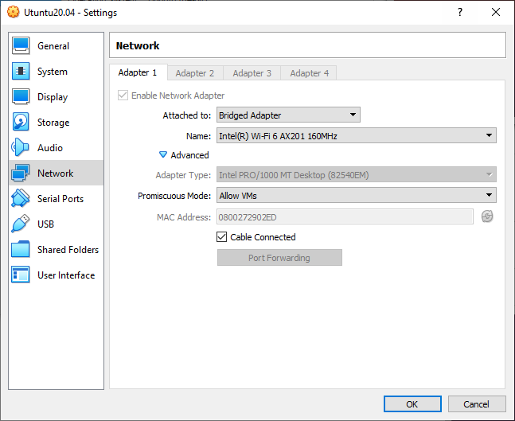
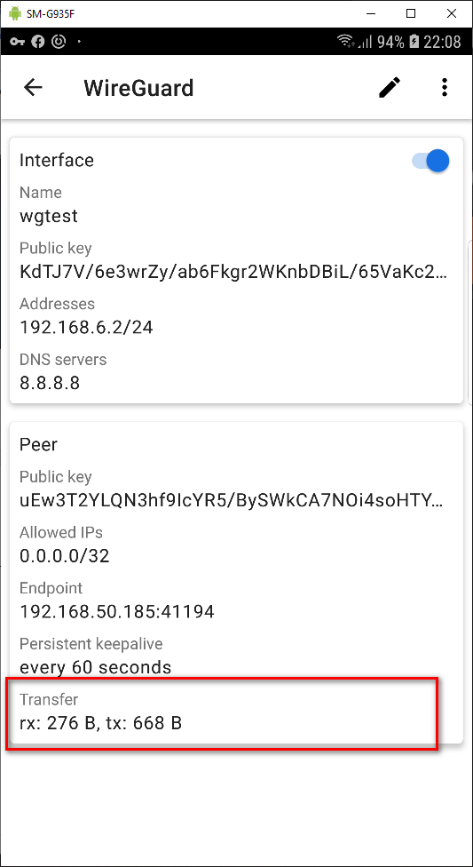
- Wired Network interface with IP configured
Local WG_VPN server and WG_client(Android Mobile) TestEnv Configuration
- Virtual Lan interface with IP configured
Bridge Adapter : 192.168.50.185
192.168.50.111
- Wireless Network interface with IP configured
Host computer
Communication Linked Protected by WGVPN.
Ubuntu VM
QS-WGVPN Server Program
Router
IP:192.168.50.1
GW0: 192.168.6.1: 41194
Customers’ Mobile Handhold Devices (SamSung)
192.168.6.2
IP: 192.168.50.157
IP:192.168.50.157

Slide 8





Customers’ Android Mobile Handhold Devices
QS-WGVPN Android App
QS-WGVPN Server Program
WireGuard VPN Server Process
WireGuard VPN Client Process
VPN Protected Data Flow
Quantum Secure Key
Quantum Secure Key Exchange Synchronize Server Process
Quantum Secure Key Exchange Client Process
Encrypted Key Exchange Synchronize data

Slide 9
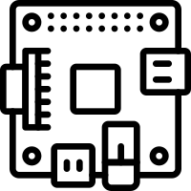
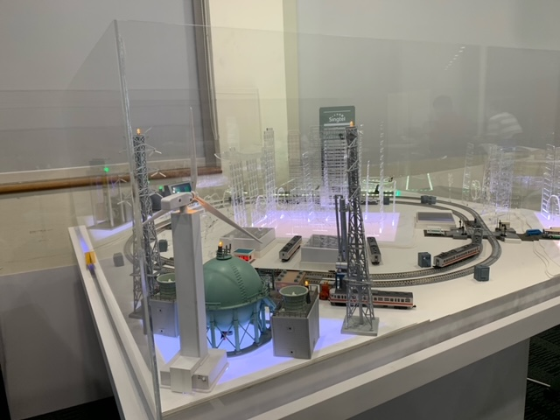
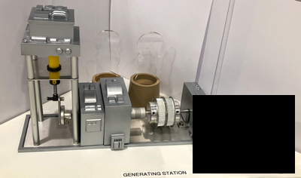
2.7 Create the fake generator turn off cmd to cut off the power supply
Technical PC
2.2 Run fake MS-word document from phishing email
2.1 Blackout Atk on cmd
IP: 192.168.10.251
2.4 Send atk active cmd
orchestrator PC
Attack Implement Raspberry PI
1.1 False data injection Atk on cmd
IP: 192.168.10.91
2.3 Scan the network and fetch PLC information.
IP: 192.168.10.91
1.2 Reverse Runway light control and feed back signal data.
2.5 Block the network, feed fake data to HMI, turn off all the output of PLC
3.1 Stealthy Substation Attack
SCADA PC
OT Railway module
Mode Bus TCP PLC control/feedback cmd
IP: 192.168.10.21
3.1 Create unstable load feed back cmd from substation module
Generator Control Raspberry PI
Generator Control Raspberry PI
Serial COM
Power
IP: 192.168.10.244
PLC IP: 192.168.10.71/72/73

Slide 10
